Slide 1
FOOD TRACKING SYSTEM USING BLOCK CHAIN TECHNOLOGY
SUBMITTED BY:
SWETHA S
BHUVANESHWARI T
VARALAKSHMI S
JAISREE V

Slide 2
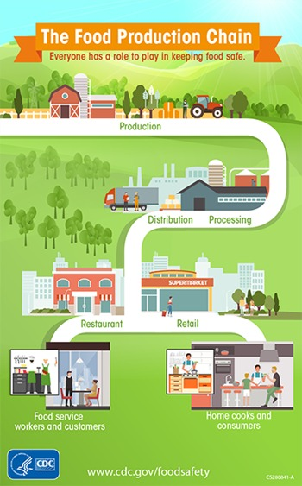

Slide 3
ABSTRACT:
Maintaining a healthy diet is essential for one’s overall well- being. In recent years, the integration of block chain technology in food tracking system has gained the significant attention due to its potential to revolutionize the way we monitor and verify the supply the chain of food products.
This provides an overview of how blockchain technology enhances the transparency and traceability within the food tracking systems.
With blockchain consumers can access the detailed information about the source, ingredients, certifications, and handling processes of a particular food product simply by Scanning a QR code or accessing a mobile applications.

Slide 4
INTRODUCTION:
A food tracking system is a tool or the applications used to monitor and keep a record of the food and beverages to consume on a daily basis.
These systems are typically used by the individuals who want to maintain a healthy diet, track their calorie intake, or the monitor the specific nutrients they to consume.
It often to include a database of the various foods and their nutritional information, allowing users to enter their meals and receive accurate data on calories, vitamins, and minerals.
Some systems also provides the features for setting goals, creating meal plans, and generating reports on eating habits.

Slide 5
METHODS FOR FOOD TRACKING SYSTEM:
With the increasing population, food consumption is also increasing simultaneously.
Accordingly, food producers or intermediaries try to reach the highest output level they can produce with their existing capacities to meet this demand and to bring the excess demand to the balance point, but the quality of these products causes various concerns in the consumer.
When the whole process is examined, seeds and supplement materials are purchased from suppliers, processed by the producer, and turned into products, then wholesaled in factories and delivered to retailers through the distribution chain. Finally, it is offered to the end-user, that is, the consumer.
Raw material purchase: Information such as product type, amount of chemical, which is the shopping information between the supplier and the manufacturer, is recorded in the blockchain structure.

Slide 6
METHODS FOR FOOD TRACKING SYSTEMS.
Planting the crop: The producer records the number and type of seeds used during planting in the blockchain structure. With a smart contract to be used here, it can be checked that no more seeds are planted from the seed taken in the previous transaction.
Cultivation: With the networked microcontrollers to be used here, information about the growing place of the product, how much water or sun it receives can be added to the blockchain. Again, when there is an anomaly with smart contracts, it can be recorded.
Harvest: During the harvest of the planted product, adding the obtained amount to the blockchain with IoT devices can be automated and it can be determined whether the product is organic through the process from seed to harvest.

Slide 7
Delivery of the product to the fabricator: Using GPS technology, the delivery process of the product to the fabricator can also be monitored with IoT devices.
Production: The amount delivered to the manufacturer can be added to the blockchain. In this way, it is possible to monitor how much loss is incurred in the transfer phase of the goods from the manufacturer to the manufacturer.
Delivery of the product to the retailer: Using GPS technology, the delivery process of the product to the retailer can also be monitored with IoT devices. The quantity and freshness of the delivered product can be recorded on the blockchain.
Consumption: The consumer can view the entire life cycle of this product, all data collected, with the help of a QR code. They can also observe how the pricing is conducted in all the above transactions.

Slide 8
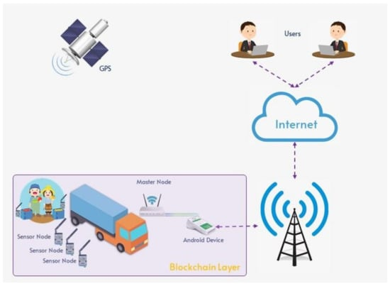
PROPOSED SYSTEM ARCHITECTURE:

Slide 9
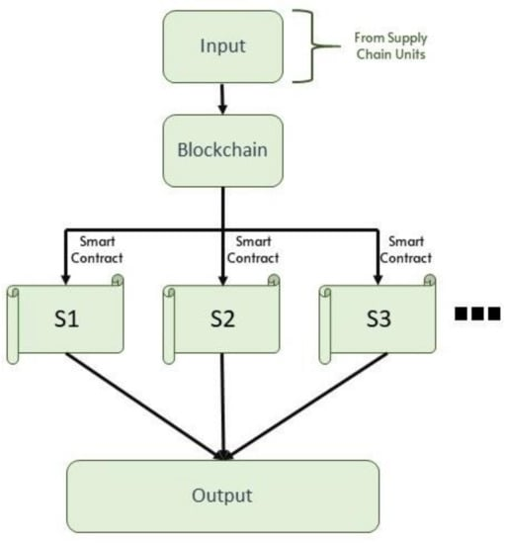

Slide 10
In the traditional approach, the data obtained from the source are transferred directly to the application layer. At this point, if there is no additional security layer, there may be cyber-attacks in the supply chain.
In addition, it is seen that the direct transfer of the obtained data to another source on a single source can only be performed in a closed way.
This is an important indication that the principle of transparency does not exist in this structure.
On the other hand, considering that blockchain technology allows the formation of chains by adding blocks end-to-end and the transparent monitoring of this chain.
It provides an important advantage for the ownership of the data does not belong to any party, that is, all participants have a copy of the data in a distributed structure. Thus, a system in which the buyer and seller can transact between themselves without the involvement of any third party will be achieved.

Slide 11
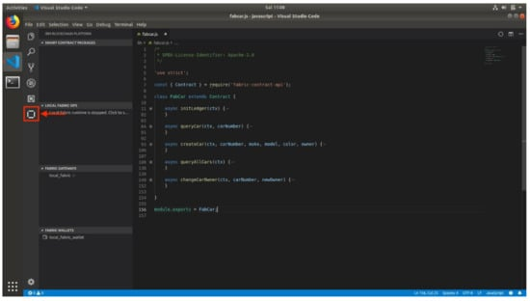
`OUTPUT SCREENSHOTS:

Slide 12
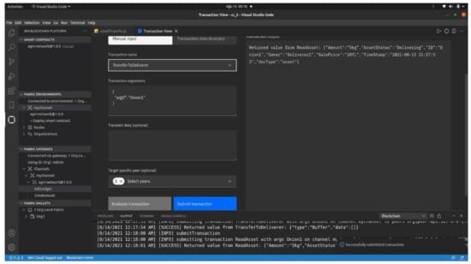

Slide 13
ADVANTAGES OF FOOD TRACKING SYSTEM
Food Traceability
Transparency
Efficiency
Smart Contracts
Improved Inventory Management
Better Compliance with Regulations

Slide 14
FUTURE SCOPE OF FOOD TRACKING SYSTEM
The Future Scope of Food Tracking System in Blockchain Technology is Promising, with several potential advancements and applications.
Integrating the technology with the Internet of Things (IoT) can enable real -time data collection from sensors and device embedded in the food supply chain.
This innovation and the improvements in the Food Tracking System of the future to continuously evolves the advancing Food Safety Techniques of the Future.

Slide 15
CONCLUSION
It has the potential to revolutionize the Food Tracking System by enhancing Transparency, Traceability, Food Safety, and Supply chain Management.
The consumers can access detailed information about the food they consume such as it origin, ingredients, and production processes, fostering trust and confidence in the Food Industry.
Overall, the implementation of Blockchain Technology in Food Tracking Systems has the potential to revolutionize the industry, improving safety standard, consumer trust, and Supply Chain Management.

